Slide 1
RESOURCE AND PROJECT PLANNING
Where the magic happens
Jean Dowson
25 May 2016

Slide 2
Contents
1 | Understand how to plan resource needs with the team to meet team and project objectives.
2 | Understand the need for change to resource requirements.
3 | Be able to monitor, record & control resources within the work area.

Slide 3
Managers and Resources
“Managers are responsible for the process of planning, organising, leading and controlling the efforts of organisational resources to achieve stated organisational goals”
(Mescon, Albert and Khedouri (1985)
All resources have a cost attached

Slide 4
What are resources?
What is the difference between a physical and a financial resource?
What is the difference between tangible and intangible resources?
What resources are you responsible for?

Slide 5
Resources are …
“Anything that is available to an organisation to help achieve its purpose”
CMI ManagementDirect

Slide 6
Types of resources
Consider ….
Tangible - physical assets such as land, buildings, vehicles, equipment, raw materials, financial, IT, etc
Intangible - no physical presence such as knowledge, skills, IPR, reputation, brand, good will, etc
Notes:
6

Slide 7
Resource Management
Efficient & effective deployment of an organisation’s resources in order to achieve project & team aims & objectives
For instance -
“Pay the right people the right amount at the right time.”

Slide 8
The Transformation Process
Inputs (Resources)
Milk, cream, sugar, people, equipment, packaging, cleaning materials, vehicles, building, IT, utilities, etc
Processes
Making ice cream, packaging, cleaning, delivery, supply, quality, HSE, etc
Outputs
Satisfied customers eating ice-cream

Slide 9
Use resources to achieve objectives effectively & efficiently
Managing resources for a building project?
Delivering services to a new customer?
Planning an office move within the same building ?
Relocating the business several miles?
Managing your team?
What part do you play in planning, bidding for and managing those resources?

Slide 10
Efficient & Effective?
Efficiency - how much it costs an organisation to produce goods and services with resources used.
Effectiveness - quality of the goods and services produced with the resources used.
more goods and services - more efficient;
better goods and services - more effective;
more and better goods and services - more efficient & more effective.

Slide 11
So where can we achieve efficiency and effectiveness?

Slide 12
Reflect and consider in your organisation …
Who manages these resources & how are they allocated and managed?
Which do you / your team use?
Which do you / your team manage & how?
Notes:
12

Slide 13
Managers Role:
Be aware of the resources your team are using and plan, manage & monitor them
and
Look out for ways to use them better, to produce more or better goods and services, or use fewer resources.

Slide 14
The Project Triangle
Time
Cost
Quality

Slide 15
Creating a Resource Plan
Ensure have enough resources but not too much (waste)
Ensure people are assigned tasks that keeps them productive but not overworked (stress)
Ensure organisational / team objectives are being fulfilled (SMART)
Keeping people informed what resources are available and when

Slide 16
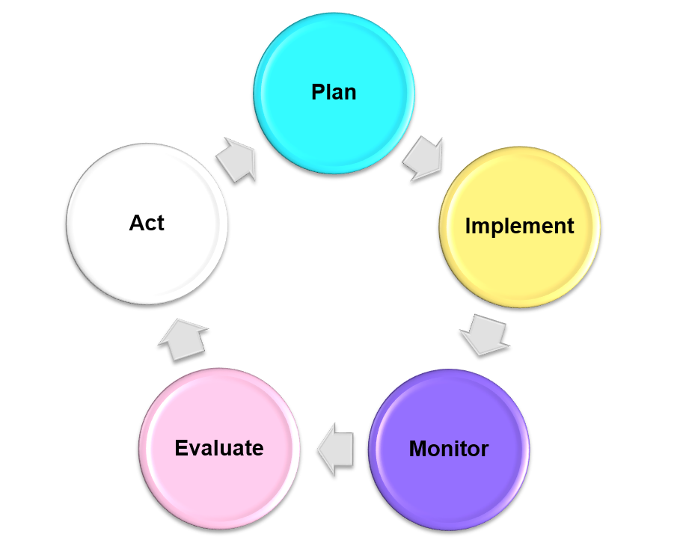
Plan What resources do we need – time v cost v quality Implement Right thing, right place, right time Monitor Measure & evaluate usage, stock, quality, etc Evaluate What went well? What can we learn? What can we do differently? Act Change if necessary
PIMEA - The Planning Cycle for Resources

Slide 17
Possible headings of your resource plan ....
Resources req (items)
Resources you already have or are shared?
How much / How many?
How to access resources (when, where, who?)
Lead time for supply?
Where are they needed?
Who needs them?
Ad hoc, planned, bid?
Management control of issue, stock, reordering
When do you need them?
People (right people, skills, place, time)

Slide 18
Whole life management
Requisition
Procurement
Purchasing
Storage
Security
Maintenance
Disposal
Whole
Life

Slide 19
Resource problems to look out for & manage
Not enough at the right time
Enough available but at the wrong time
Poor quality
Wrong type
Available but not under your control
Not accessible – wrong place
No accountability/ management
Wasted due to lack of involvement in purchase or allocation

Slide 20
How can we monitor resources
Inventories
Stock sheets
Time sheets
Mileage records
Leave records
Budgets
Sales records
Accurate
Relevant
Appropriate
Up to date
Secure
Comply with regulations

Slide 21
Factors that impact on resources
Social
Technical
Economic
Environmental
Political
Legal
Ethical
(Ian Favell 2004)

Slide 22
STEEPLE
Socio-cultural Population demographics Income distribution Social mobility Life style changes Attitudes to work and leisure Consumerism Levels of education |  | Technological Government spending on research Government and Industry focus of technological effort New discoveries/ development Speed of technology transfer Rates of obsolescence |  | Economic Business cycles Interest rates Money Supply Inflation Unemployment Disposable Income Energy availability and cost
Environmental Environmental protection culture Nature of environmental resources Environmental stakeholders Environmental legislation |  | Political Taxation Policy Foreign Trade Regulations Government stability Party structure Election schedule |  | Legal Competition legislation Environmental protection laws Taxation law Employment law H&S Law Legal controls & legislation
Ethical Reputation Honesty Values | Moral Issues Corporate Social Responsibility

Slide 23
REFLECTION ON STEEPLE
What external influences might affect resource planning in your organisation?
Notes:
23

Slide 24
SO WHAT?
How might these factors impact on your resource planning?
How might that in turn impact on your team objectives?
How will you need to adjust your plan?
Notes:
24

Slide 25
“How can you be more efficient and effective…”
Make sure the resources you have are contributing to a positive IMPACT in the workplace.
How will you recognise impact?
How can you measure it?
Contingencies?

Slide 26
You have a lot on your shoulders ..
Economic forces and change
Social and political change
Organisational change
Changes in markets, services and products
New systems and technology

Slide 27
Learning Outcomes
Understand how to plan resource needs with the team to meet team and project objectives.
Understand the need for change to resource requirements.
Be able to monitor, record & control resources within the work area.

Slide 28
QUESTIONS
COMMENTS
QUERIES
FEEDBACK

Slide 29
AAT Annual Conference 2016 10 - 11 June, Birmingham
The AAT Annual Conference is an essential CPD and networking event for all finance professionals.
Why attend?
Connect with 300 accounting and finance professionals from across the UK.
Hear from new and popular speakers on key industry topics.
Choose from over 20 sessions with our extended programme.
Enjoy interactive workshops and unique sessions that aren’t covered at other AAT events.
See how AAT can further your career.
Find out more and book your place at aatconference.co.uk

Slide 30
Disclaimer
The information contained in this presentation or delivered in relation to it has been compiled by the author with every bit of accuracy. AAT is not responsible for any veracity, not for any opinions expressed within or in relation to it.
By receipt of this information, directly or indirectly, you the attendee or recipient release AAT and any of its officers, directors or employers, jointly or individually from any actions, damages, responsibilities, claims or losses as a result.

