Slide 2
CI - CIO
Charity Information and
Charitable
Incorporated
Organisations
Ken Brew, Head of Charities, Henton & Co.

Slide 3
Legal forms for a charity
Existing
A charitable trust (deed)
A charitable association – membership body
A charitable company – limited by guarantee
New
A CHARITABLE INCORPORATED ORGANISATION

Slide 4
Problems with Existing Legal forms
Trusts – No protection of limited liability
Companies
Corporate status and limited liability BUT
Compliance with Company and Charity law
Dual status (Company director and Charity trustee)
Dual notification (Companies House and Charity Commission)
Dual submission (Accounts to CH and CC – different deadlines)
Dual compliance (Company Law and Charities SORP)

Slide 5
Government Policy
“Making it easier for people to set up and run a charity”
Charitable Incorporated Organisation (CIO)
The perfect solution? A simple concept.
A CIO is a corporate body with limited liability
Registered and regulated solely by the Charity Commission
Limited liability without Company Law
Single Regulator
With tax advantages of a charity

Slide 6
CIO – long gestation period
Original idea
2002 Cabinet Office report……………………
“Private Action Public Benefit”
Mechanism
Charities Act 2006………………………………
Delivery
CIO Regulations (November 2012)
E&W registration from January 2013 onwards!

Slide 7
CIO – Loss of impact?
Many charities waiting and postponing their decisions
SCIO effective from 1 April 2011
E&W Regulations much more complex drafting than those in Scotland
Delays due to complexities, events, reduced resources etc.
Not a panacea but may suit some charities in particular circumstances

Slide 8
CIO conversion from Unincorporated body
To become a CIO, a new CIO charity must be formed
The old charity agrees to wind up
Transfer (all) assets from the old charity (Expenditure)
New charity receives the assets (Incoming resource)
Market value at the date of the transfer?
Simplest if all of the assets are transferred at the year end date BUT…
This requires planning and preparation

Slide 9
CIO conversion from a Company
It will be possible to convert without a winding up but the Regulations have still to be finalised…
Conversion can take place any time (in theory) – mid year?
No transfer of assets but ”a new wrapper”
Communication between Companies House and the Charity Commission will need to be good.

Slide 10
Charity Commission Registration timetable for CIOs
From 10 Dec 2012 New charities > £5k income
Unincorporated
From 1 Mar 2013 Existing > £250k
From 1 May 2013 Existing > £100k - £250k
From 1 July 2013 Existing > £ 25k - £100k
From 1 Oct 2013 Existing > £ 5k - £ 25k
From 1 Jan 2014 Existing < £ 5k
During 2014 onwards Company conversions

Slide 11
CIO Distinctives
“the charity trustees of a CIO” are
NOT directors
MAY be called “a board” but no definition in Law
CAN be a Membership organisation
OTHERWISE Members = trustees
TWO Model Constitutions
Principal office in either England or Wales
Could be a PO Box
SCIO has principal office in Scotland
UK wide operation needs CIO to be registered with OSCR

Slide 12
CIO Distinctives (cont.)
CIO needs to keep a Register of members and a Register of trustees.
CIO has its own legal identity apart from the trustees.
CIO needs to submit Annual Return and
CIO needs to submit accounts to the Charity Commission.
But CIO has no “de minimis” limit on accounts submission (£25k) or Registration (£5k)

Slide 13
CIO Distinctives (cont.)
CIO can use Receipts and Payments format for accounts
(If annual income is below £250k income)
Company Law does not permit this for companies…
There is a reason – what happened to it?
Will stakeholders allow R&P in practice?

Slide 14
CIO Issues and Problems
The Charity Commission does not keep a Register of Charges for CIOs regarding Debentures and Loans like Companies House – will this impair the ability to raise future loan finance?
When does jurisdiction transfer from Companies House to the Charity Commission – submission of accounts in the gap?
You can convert to a CIO but you can’t convert from it. Will you have to dissolve it?
What happens if CIO ceases to be charitable?
Conversion might crystallise existing liabilities – e.g. pensions

Slide 15
CIOs may be advantageous when…
Unincorporated associations want reduced trustee liability.
Charities struggle with the administrative burden of registering and filing accounts with Companies House.
Organisations want trustees aged 16-18 on their governance board.
Individuals or groups want to set up a charity with limited member rights.

Slide 16
CIOs maybe a disadvantage for…
Organisations that might want to want to borrow money in future.
Individuals and groups looking to set up an organisation quickly.
Unincorporated charities with contingent liabilities such as those arising within a defined benefit pension scheme.
Corporate charities with able staff and advisors so that they do not struggle with the administrative burden of registering and filing accounts with Companies House.
Unincorporated charities that are unlikely to enter into contracts.

Slide 17
Charity Information
Overview of the Framework
Layering of accounts - activities
Exploring the Charity Commission’s website
Looking at Macro data

Slide 18
Proposed Accounts requirements England and Wales (From March 2009)
Income | ≤ £10k | £10k-£25k | £25k-£250k | £250k-£500k | £500k
Accounts | Cash basis (non-company) Accruals basis (company) |  |  | Accruals basis
 |  |  |  | Simpler? | Full
Trustees’ annual report | Simple |  |  |  | Full
Scrutiny | None |  | Independent Examination* |  | Independ-ent Audit
 |  |  | Independent Person | Qualified Accountant
Report to regulator | Update form | Simple return, report and accounts |  |  | Return, report & accounts
* if Income >£250k and assets >£3.26m audit required. Company charities May have IE.

Slide 19
Statement of Financial Activities Layering

Slide 20
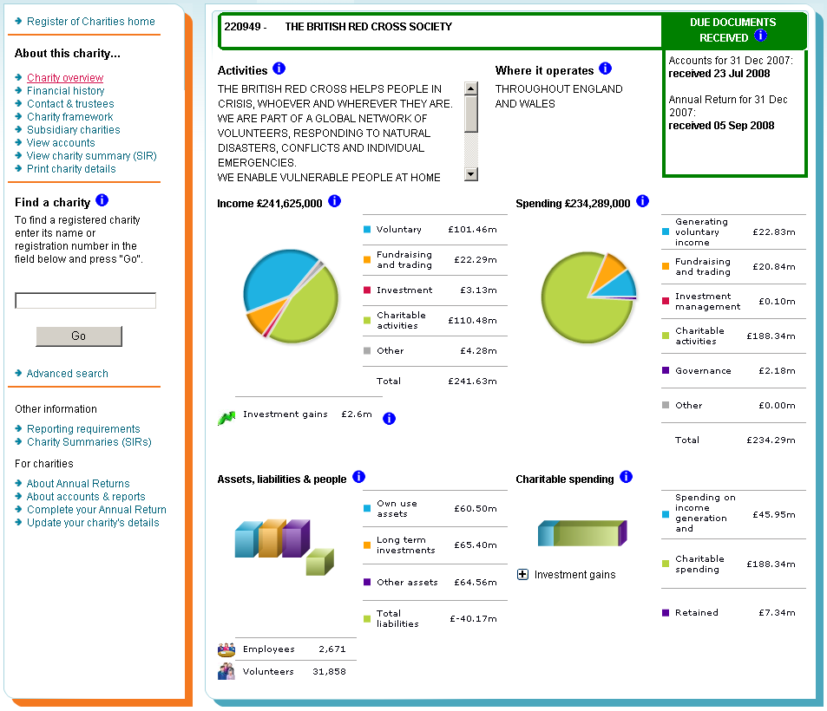
The Register of Charities

Slide 21
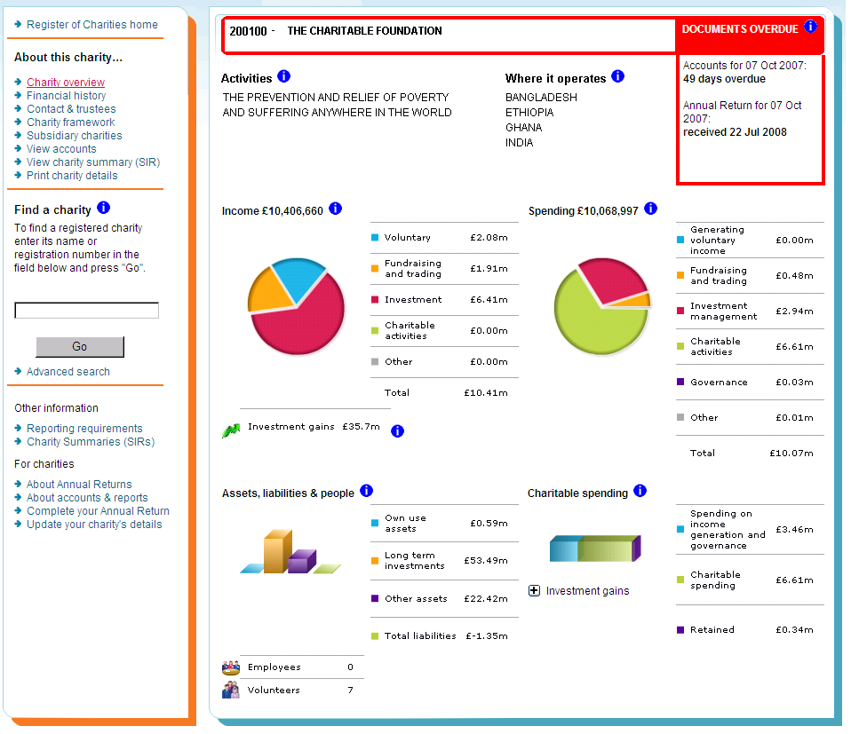
The Register – documents overdue

Slide 22
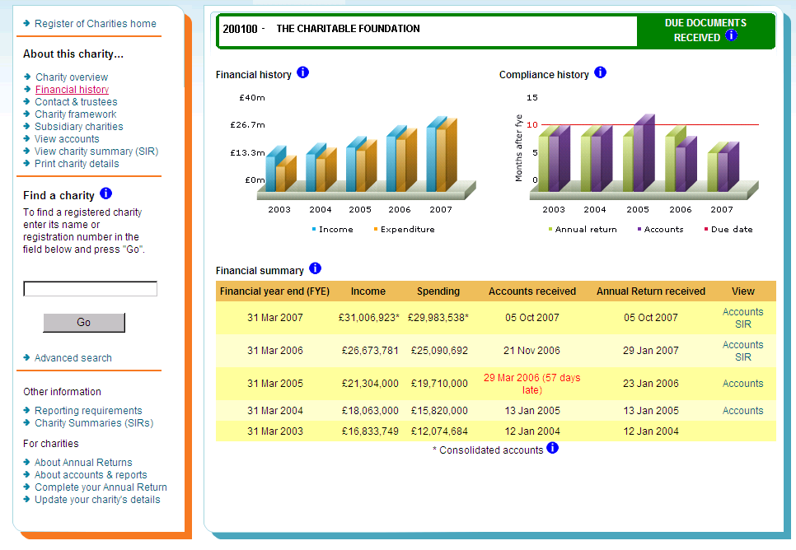
The Register – financial history

Slide 23
Useful Websites
http://www.charity-commission.gov.uk/
www.charitytrends.org
http://www.civilsociety.co.uk/directory/company/2765/office_for_civil_society
www.legislation.gov.uk/ukpga/2011/25/enacted
http://www.kubernesis.co.uk/resources/

Slide 24
Any questions?

