Slide 1
growth through innovation david evans

Slide 2
Mr President

Slide 3
DJE Advisory Services
Strategy development
Shareholder planning for succession and exit
Turnaround and change management planning and implementation
Board effectiveness

Slide 4
innovation
Introducing something new
More effective service / product / process
New values through solutions that meet new requirements
Creates value
Catalyst for growth

Slide 5
invention - doing a completely different thing (starting again)
innovation
improvement - doing the same thing better (tweaking)

Slide 6
INNOVATION IN ACCOUNTANCY

Slide 7
Our challenge:
to unlock innovation potential in our businesses to drive transformational growth

Slide 8
But, we need to dig deeper …..

Slide 9
Innovation, the big picture:
4 mega trends
3 faces of innovation
1 left field view

Slide 10
4 mega trends
1.
Globalisation

Slide 11
4 mega trends
1.
Globalisation
2.
Virtualisation

Slide 12
4 mega trends
1.
Globalisation
2.
Virtualisation
3.
Millennial Generation

Slide 13
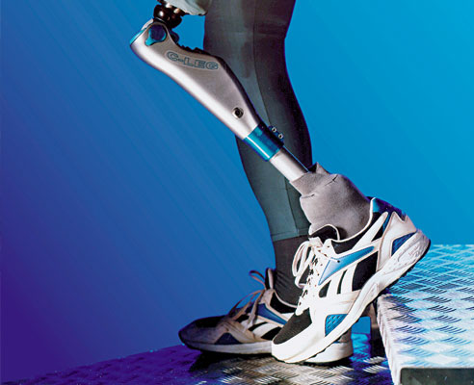
4 mega trends
1.
Globalisation
2.
Virtualisation
3.
Millennial Generation
4.
Technology Advancement

Slide 14
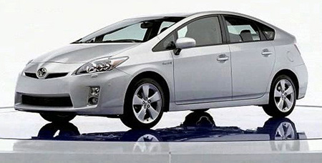
3 faces of innovation
Empowering innovations
Sustaining innovations
Efficiency innovations

Slide 15
THE LEFT FIELD VIEW
sustaining innovations
disruptive innovations

Slide 16
Our response
Innovate or stagnate
It’s a state of awareness
Keep it simple, stupid
Frugal not profligate

Slide 17
Because …
Breakthrough innovations are few and far between and even the game changers are often accidental.
Innovation doesn’t need to cost a lot.
You don’t need a PhD to have a good idea.

Slide 18
The market questions
Why do customers buy from you now? (Differentiators/USP)
What will be different about your market in 3 years?
Why will customers buy from you in 3 years?
How does the opportunity and threat of globalisation impact your supply chain, customer base and internal resource?

Slide 19
The market questions
Are you…
continually re-assessing/renewing your differentiators?
changing with/leading change within the market?
seeking niche responses to the fracturing of mass markets?
recognising that “access to “ is more significant than “ownership of”?
recognising increasingly ubiquitous competition?

Slide 20
Some market statistics:
Britain is the highest online shopping nation in the world, with almost two thirds using the internet to purchase.
Online retail sales soared in December with the high street struggling.

Slide 21
The people questions
Do you understand the different paradigm of the “Millennial Generation”?
challenges internal organisational models and cultures
prioritises CSR and work/life balance
routinely engages social networks at every stage

Slide 22
The people questions
Are you recognising:
increasing significance of remote working and virtual teams?
the breakdown of “command & control” culture?
technological advancements?
the impact of globalisation on your teams and structures?

Slide 23
The people questions
Are you planning for:
more freelance and outsourcing?
less employed and insourced?

Slide 24
implications for leaders
Strategies are seen through the lens of the past – need continual re-assessment against the different paradigm of future.
Regular time-outs to detect early warning of change.
Need to tap into different sources of data insight.

Slide 25
But, the basics remain …
Deep strategies
Razor sharp focus
Leading edge delivery

Slide 26
Table discussions
How have you seen these changes being evidenced in your business / your clients’ businesses?
How have you / they adapted as a consequence?

Slide 27
Q & A

Slide 28
Your next session
There is now a refreshment break until 11:25 in the Deansgate foyer (first floor). After this the sessions are:
HMRC’s Agent Strategy - Deansgate 1 and 2 (first floor)
Implementing auto enrolment successfully - Deansgate 3 (first floor)
Sustainability in practice - Room 2, 3 and 4 (first floor)

