Slide 1
Tax Investigations Workshop

Slide 2
Topics
New penalties regime
Discovery assessments
Time limits for assessments
HMRC information notices
Data Protection Act issues (Quickly)
Disclosure Facilities

Slide 3
“New” Penalties Regime

Slide 4
The “new” error penalty regime
Penalty regime introduced by Schedule 24 FA 2007. Applies to any accounting period etc beginning after 31 March 2008, for returns due to be filed after 31 March 2009.
The regime focuses on the behaviour of the taxpayer,
Mistake despite taking reasonable care
Careless
Deliberate but not concealed
Deliberate and concealed
Fixed ranges of statutory penalties
HMRC define ‘carelessly’ as without reasonable care and equate this to negligence as per the old penalty regime
Percentage reductions for disclosure, but lowest penalties are for unprompted disclosure only

Slide 5
When is a penalty chargeable?
Where a person gives HMRC an inaccurate return or other document, which satisfies the two conditions below:
the inaccurate document either amounts to or leads to
an understatement of a person’s liability to tax, or
a false or inflated statement of a loss, or
a false or inflated claim to repayment of tax, and
the inaccuracy was careless, or deliberate

Slide 6
HMRC Behaviour Policy

Slide 7
Quality of disclosure
Standardised penalties, reduced by ‘Quality of disclosure’
The mitigation is based on Quality of disclosure but the % reduction is limited to the difference between Standard and Minimum penalties
Quality of disclosure focuses on : ‘telling’ ‘help’ & ‘access’:
A person discloses an inaccuracy or a failure to disclose an underassessment by:
(a) telling HMRC about it,
(b) giving HMRC reasonable help in quantifying the inaccuracy or under-
assessment, and
(c) allowing HMRC access to records for the purpose of ensuring that the
inaccuracy or under-assessment is fully corrected

Slide 8
Deliberate behaviour – HMRC view
“A&B Ltd, a large company with a substantial advertising budget, does not have procedures to identify the entertaining element of advertising costs. So any expenditure on advertising is included in full in the advertising account, with no way of cross-checking how much of the expense relates to disallowable entertaining.”
HMRC’s view:
“This would at least indicate failure to take reasonable care and could be shown to be deliberate. A&B Ltd’s basic systems and procedures are inadequate to give appropriate levels of assurance.”
Although this is a company example it is not difficult to imagine similar scenarios for individuals (e.g. allowable expenditure for CGT purposes)

Slide 9
Some from the latest ‘Name and Shame’
Name | Business, trade or occupation | Address | Penalty amount | Total amount of tax/duty on which penalties are based | %age
Roofseal GRP Products Ltd | Supply Roofing Products | 6 Humber Street, Grimsby | £22,413 | £53,365 | 42.00
Mr Philip Thompson | Road Haulage | County Antrim | £25,361 | £38,138 | 66.50
Serkan Gokmen | Kebab Shop | City Rd, Peterborough | £21,336 | £42,041 | 50.75
James Joseph Farmer | Painter/ Labour provider | Belfast, | £132,193 | £222,173 | 59.50
Mr Euan Anderson and Isobel Anderson | Public Bar & Food Sales | Ayrshire | £51,859 | £77,984 | 66.50
Mr Scott Johnson | Public House | Manchester | £15,773 | £25,753 | 61.25
G S Services London Ltd | Construction Labour Supply | North Finchley, London. | £356,220 | £508,887 | 70.00
Carraroe Construction Ltd | General Construction | West Norwood, London, | £75,716 | £139,568 | 54.25
Alexander Black Recruitment Ltd | Permanent and Temporary Recruitment | London | £66,561 | £111,189 | 59.86
Mr Mohammed Atiq Mir | Tandoori Restaurant and Takeaway | Blackpool | £19,201 | £34,288 | 56.00
Paymaster Ltd | Labour provider | Birmingham | £1,115,481 | £1,991,931 | 56.00
EU Oil Ltd | Wholesale Petroleum and Petrol products | Harlow, Essex | £719,212 | £1,053,791 | 68.25
Westnew Management Ltd | Manage Real Estate | Tyne & Wear | £135,364 | £209,056 | 64.75

Slide 10
Penalty applied to the ‘PLR’
Concept of Potential Lost Revenue (“PLR”)
Where tax due (or erroneous repayment claim) it is simply the tax due (or over-claimed)
But- Group Relief and Section 419(4) relief now ignored-
And there can be a penalty where no tax due
In loss cases PLR = 10% of the loss. Not just Corporates - Consider Farmers, property letting, Capital Losses (shares with negligible value)
In delayed payment cases PLR = 5% of the adjustment per year of delay

Slide 11
Suspended Penalties and the £54 million mistake
Suspension of penalties
careless inaccuracy only
agreement of corrective actions
can only apply to matters that can be repeated – Correction – HMRC may only suspend if condition of suspension would help the Person to avoid becoming liable to further penalties for careless inaccuracy
period of suspension may not exceed two years (from date of notice)
a suspended penalty becomes payable if during the period of suspension the taxpayer becomes liable for another penalty for careless inaccuracy – No appeal
penalty only cancelled (in part or whole) if all conditions of suspension complied with

Slide 12
Penalties for Failure to Notify
Failure to notify
Penalties applying for accounting periods ending on or after 31 March 2010
3 types of failure to notify (The potential lost revenue (PLR) from a failure to notify chargeability for corporation tax is the amount of tax that is unpaid 12 months following the end of the accounting period)

Slide 13
HMRC errors in application of penalties
Confusion of old regime and new regime
Consideration of prompted and unprompted in old regime
(Old regime, prompted can still be zero – 20% disclosure, 40% cooperation, 40% size and gravity)
Failure to consider suspension of penalties and
In contrast, suggestion that because penalty is to be suspended, no need to argue
Failure to notify – Can only apply if a return has not been issued
If Return issued but not submitted, failure to submit Return but not failure to notify.
If Return submitted but income/source omitted, penalty for incorrect Return
Unwillingness to accept the concepts of innocent error or ‘careful’ error

Slide 14
Discovery Assessments

Slide 15
Discovery
Section 29 TMA 1970
Where the taxpayer has made and delivered a return …he shall not be assessed …unless one of the two conditions mentioned below is fulfilled.
(4) The first condition is that the situation mentioned in subsection (1) above was brought about carelessly or deliberately by the taxpayer or a person acting on his behalf.
(5) The second condition is that at the time when an officer of the Board–
ceased to be entitled to give notice of his intention to enquire into the taxpayer’s return under section 8 or 8A of this Act in respect of the relevant year of assessment; or informed the taxpayer that he had completed his enquiries into that return,
the officer could not have been reasonably expected, on the basis of the information made available to him before that time, to be aware of the situation…

Slide 16
Limitations
HMRC Statement of Practice 1/06
The authority to make a discovery assessment is given by S29 TMA 1970 (ITSA), Para 41 Sch 19 FA 1998 (CTSA). In all cases, the relevant requirement for the purposes of this Statement is a discovery "that an assessment to tax is or has become insufficient".
Mere suspicion that an assessment may be insufficient is not adequate grounds for making a discovery assessment.

Slide 17
HMRC Practice
Assess and let taxpayer argue at Tribunal
Tribunal considers merits of the assessment before validity
Potentially swayed by amounts
Note interconnection of behaviour to both time limits and penalties
Double incentive for HMRC to argue careless/deliberate
Defence
Quality of disclosure – White space, in return, documents, accounts, other information – inhibits HMRC’s ability to ‘discover’

Slide 18
Time Limits For Assessments

Slide 19
Income tax assessment time limits (Sections 34 & 36 TMA 1970, Schedule 39 FA 2008)

Slide 20
HMRC Information Notices

Slide 21
HMRC Information Powers (Schedule 36 FA 2008)
Power to check a taxpayers ‘tax position’
‘Taxpayer notices’ can be issued to taxpayer or third party
NB 3rd party can now be asked for information as well as documents
New power to enter business premises to inspect records and assets
Inspection power re domestic residences used for part business purposes
No right of appeal against request to produce statutory records
Visits to business premise may be unannounced
And also
Pre-Return checks (Compliance Handbook 205330) – real time checks into tax planning or avoidance schemes as they are being developed or implemented

Slide 22
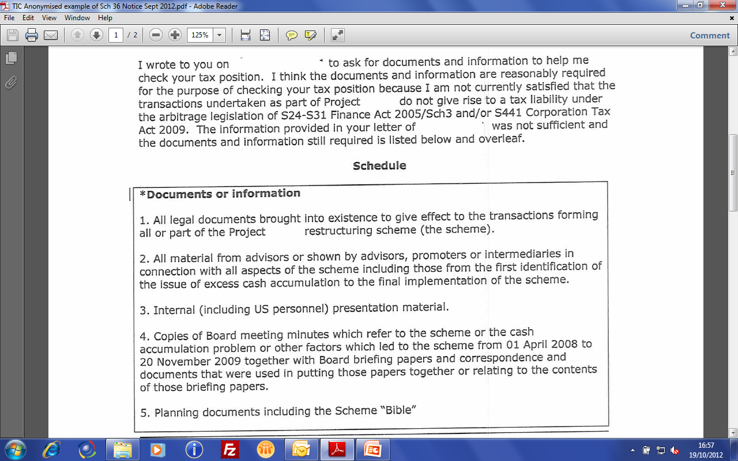
A “Kitchen Sink” Request (Corporate example but the same principles apply…)

Slide 23
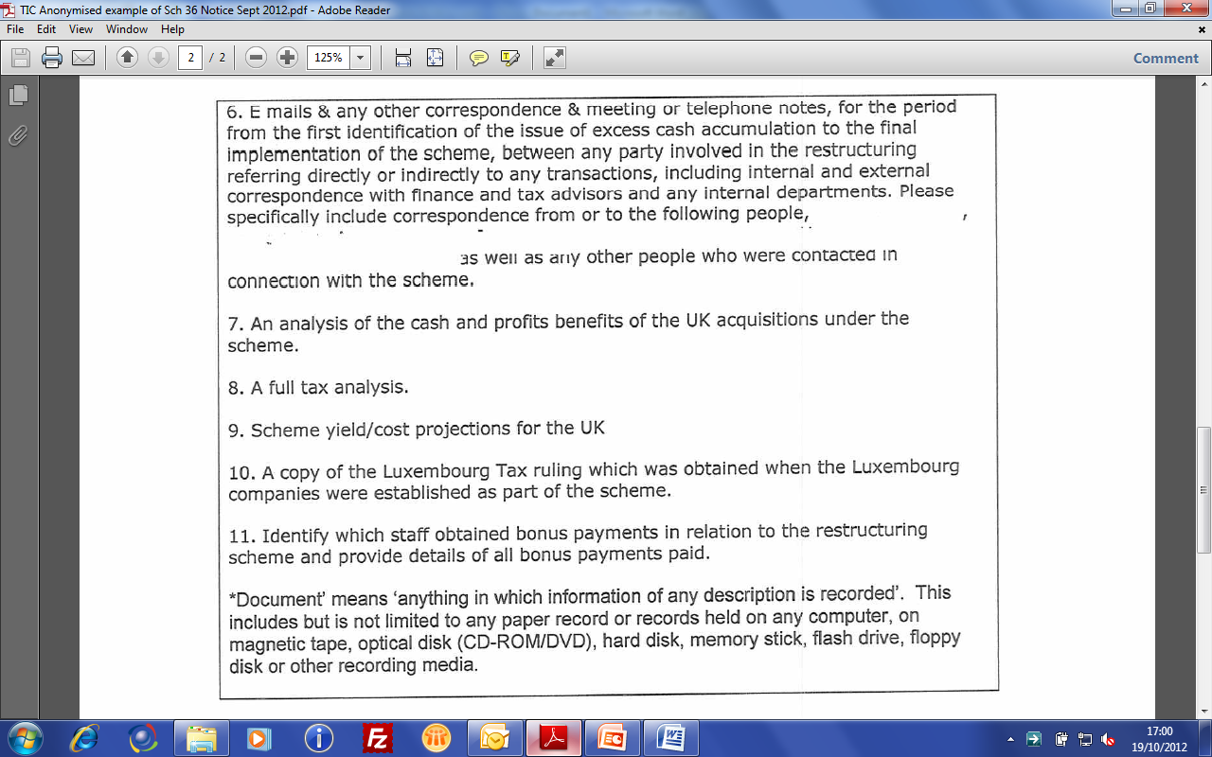
And it goes on…

Slide 24
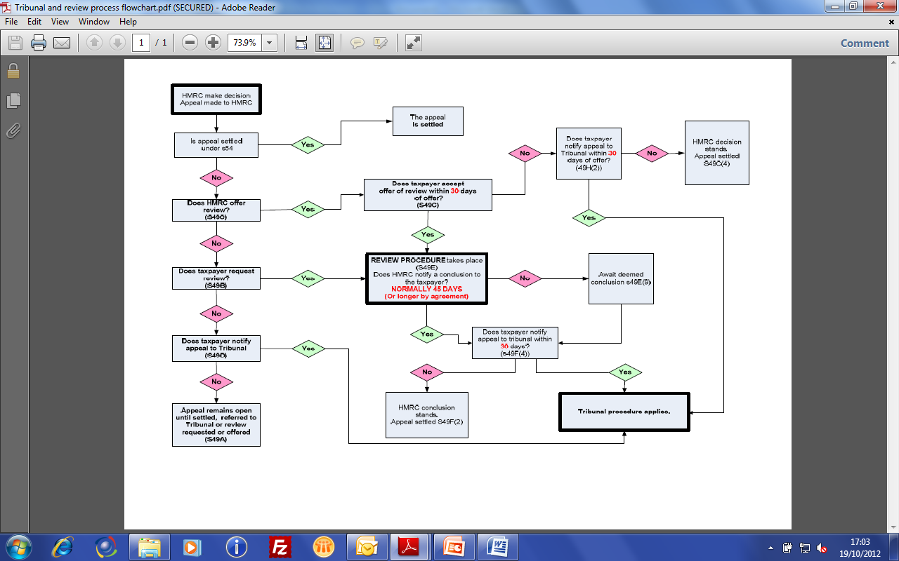
Appeals Process

Slide 25
Some (but not all) possible grounds of appeal
Possession or Power
Relevant to the determination of the tax position
Reasonably required
Unduly onerous – both in amounts required and time for provision
Need to review and redact
But beware the war of attrition – HMRC will win

Slide 26
DATA PROTECTION ACT ISSUES
(Read examples at your own leisure)

Slide 27
Compare and Contrast
Tax Legislation | Data Protection Act 1998 (DPA)
HMRC can require taxpayers (individuals, trusts, partnerships, companies) to provide documents and information | The DPA inhibits the disclosure of ‘personal’ and ‘sensitive personal’ data unless particular criteria are met (typically it has to be necessary and does not ‘prejudice’ the individual)
Failure to do so can result in the imposition of penalties | Failure to do so – i.e. disclosing information that should not be disclosed – can result in the imposition of penalties.
 | Besides the financial cost there can be a high reputational cost because fines for offences are publicised

Slide 28
DPA Personal and sensitive personal
Personal data – defined as data which relates to a living individual who can be identified from the data
For example:
Name;
Age;
Date of birth;
Home address
Sensitive Personal Data - personal data consisting of information as to:
racial or ethnic origin of the data subject;
political opinions;
religious beliefs or other beliefs of a similar nature;
membership of a trade union;
physical or mental health or condition;
sexual life;
the commission or alleged commission by him of any offence;
court proceedings for alleged or committed offences.
Skip

Slide 29
Where’s the conflict?
Example 1
Client company runs substantial property portfolio. Mainly let but some sold each year. Oversight leads to omission of one sale. HMRC seek sight of the client property database to confirm no further omissions
Client provides database. Columns showing full address and postcode of property, date property purchased, purchase cost and costs of purchase, date let, letting income, letting costs, rates, water rates etc, and, where sold, date of sale, sale price, costs of sale, name of purchaser(s), land registry number, stamp duty paid on sale, VAT paid on sale of commercial property etc etc
Spot the error that breaches the DPA?
Data contains the name of the purchaser(s) and the address of the property purchased. As these are residential properties, these are ‘living individuals who can be identified from the data’
Information regarding the names of the purchasers is not reasonably required by HMRC to determine the tax liability of the vendor

Slide 30
Where’s the conflict?
Example 2
HMRC undertaking full PAYE audit. Request full employee database
Database shows name of employee, NINO, Date of birth, address and postcode, position in company, pay grade, gross pay, superannuation, benefits, tax deducted, tax code operated, NI deducted, employer’s NI paid
Spot the error that breaches the DPA?
Arguably, position in company and pay grade not reasonably required for determination of PAYE audit
Employee database also contains details of next of kin (to contact in case of emergency), nominated beneficiary in case of death, home telephone and personal mobile phone numbers (for emergency contact), Trade Union Membership (for automated deductions), and bank account sort code and account number for direct payment by BACS/CHAPS
Latter is clearly ‘personal’ (and in some instances sensitive personal) data, and cannot be said to be necessary for HMRC to check the tax position of the employer

Slide 31
HMRC Position (in case they aren’t aware of it)
Official HMRC instructions warn HMRC officers not to seek information that breaches DPA that is not relevant to the determination of tax liability
See for example IHTM 09392 –
“It is a criminal offence not only to disclose information to another person, but also to ask for (procure) information from a data user, where it is known that disclosure would contravene the DPA. The maximum penalty for contravening the non-disclosure provisions of the DPA is on summary conviction, a fine not exceeding the statutory maximum (currently £500,000) or on conviction in indictment, a fine that can be unlimited. (For the offence of procuring disclosure the information would have to be obtained. Asking for non-disclosable information could constitute an attempt to procure, which is also a criminal offence.)”

Slide 32
Convincing HMRC
However, these instructions and the way in which the DPA applies, are not always commonly understood within HMRC
References to the DPA as preventing the provision of information are sometimes misinterpreted by HMRC as representing attempts to deny access to information
It is important to stress to HMRC that they, as well as us, are under an obligation to comply with the DPA and it is therefore in everyone’s interests that we do not provide (and they do not ask for) information in breach of it

Slide 33
Disclosure Facilities

Slide 34
Background
2007 – Offshore Disclosure Facility (ODF) (the one and only)
2009 – New Disclosure Opportunity (NDO) – from 1/9/09 to 30/11/09, extended to 4/1/2010 (The last chance)
2009 – Liechtenstein Disclosure Facility (LDF) – from 1/9/09 to 31/3/2015, extended to 31/3/2016 (The unique opportunity)
Other sundry facilities
March 2010 – Medical professionals – Tax health plan (THP)
March 2011 - Plumbers, gas fitters and heating engineers (Plumbers Tax Safe Plan – PTSP)*
Oct 2011 - Tax Catch Up Plan for tutors and coaches (TCUP)
Feb 2012 – Electricians Tax Safe Plan (ETSP)
And others we might have missed…
Generic guidance available - http://www.hmrc.gov.uk/campaigns/guide.pdf
* Not to be confused with Polytetrafluoroethylene – PTFE – Plumber’s tape

Slide 35
The last opportunities?
HMRC document “No safe havens – Our Offshore evasion strategy 2013 and beyond”– envisages no more amnesties/disclosure facilities but a focus on building an ‘Offshore Evidence database’
“400 gigabytes of data is still being analysed but early results show the use of companies and trusts in a number of territories around the world including Singapore, the British Virgin Islands, the Cayman Islands, and the Cook Islands. The data also exposes information that may be shared with other tax administrations as part of the global fight against tax evasion.”
Isle of Man, Jersey, Guernsey disclosure facilities may be the last?
The choice of disclosure facility is not straightforward.

Slide 36
Any Questions?
Thank you for attending – we were
dave.jennings@mazars.co.uk
0161 831 1151
07881 283 409
tony.monger@mazars.co.uk
0207 063 4628
07989 352 991

