Slide 2
Implementing Auto Enrolment Successfully
Andy Agathangelou, Head of Strategic Relationships, Close Brothers Asset Management

Slide 3
Auto-enrolment represents a seismic shift in the UK’s pensions landscape

Slide 4
The best approach for this session
Interactive workshop format
Let’s focus on the bigger picture, not the nitty-gritty
All the detail is also available here: http://www.thepensionsregulator.gov.uk/employers/detailed-guidance.aspx
PDF copies available on request
Notes:
4

Slide 5
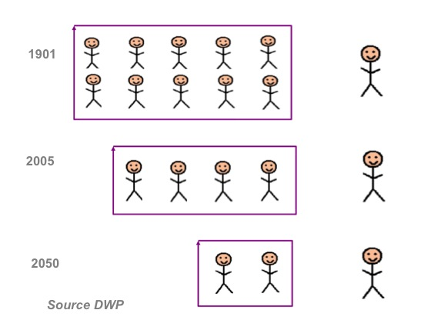
Number of people working to every pensioner

Slide 6
The background
Lord Turner
2003-2006 Chair of the Pensions Commission
Main architect of Pensions Reform
Fairer and more generous State Pension
Low cost pension aimed at low-to-moderate earners
Automatic enrolment into workplace pension schemes
Compulsory minimum employer & employee contributions
The New Employer Duties
Notes:
6

Slide 7
What are the headline requirements?
To have a Qualifying Workplace Pension Scheme
To auto enrol all eligible jobholders
To ensure contributions meet with minimum requirements
To provide prescribed information to employees
Overseen by The Pensions Regulator
Extensive new powers

Slide 8
When do these changes take effect?
Number of PAYE staff | Staging date
50,000+ | Q4 2012
10,000 – 49,999 | Q1 2013
4,000 – 9,999 | Q2 2013
1,250 – 3,999 | Q3 2013
500 – 1,249 | Q4 2013
250 – 499 | Q1 2014
160 – 249 | 1st Apr 2014
90 – 159 | 1st May 2014
62 – 89 | 1st July 2014
0 - 61 | Aug 2014 to Apr 2017
New employers | May 2017 to Feb 2018
Employers can choose to auto enrol from October 2012 or postpone by 3 months from staging date
Employers should start preparing for AE 18 – 24 months prior to staging date

Slide 9
To do list
Understand the consequences of non-compliance and the risks
Create complete and accurate data
Assess your workforce
Model the financial impact
Establish at least one Qualifying Workplace Pension Scheme
Implement Auto Enrolment
Communicate compliantly
Report as required
Re-assess each pay reference period
Project manage inclusively
Notes:
15 May 2013
9

Slide 10
Operational risks
Stage 1 Warning
Compliance / unpaid contribution notice
Stage 2 Wake up call
Fixed penalty £400
Stage 3 Serious / persistent offender
Escalating penalties:
500 + employees = £10,000
250 – 499 = £5,000
50 – 249 = £2,500
5 – 49 = £500
1 – 4 = £50
Per day!
Notes:
15 May 2013
10

Slide 11
Create complete and accurate data
“Auto Enrolment is a data management issue on an industrial scale!”
You cannot require employees to provide you with any information at the point of enrolment - it must be automatic, with no input needed from the employee whatsoever
You therefore need to have all the information you need in advance
You will require much more data than you probably hold at the moment
This step alone may be a substantial and time-consuming task
You will need to report on:-
Full employee data
Contracts
Eligibility data
Membership data
Contribution payments and dates
Automatic enrolment dates
Details of your Qualifying Workplace Pension Scheme(s)
Opt in notices
Opt out notices
Opt out data
Individual records

Slide 12
Assess your Workforce
AE effects full time and part time employees, agency workers, offshore workers and some contractors on payroll
You will have to assess each worker individually
You will have to re-asses every pay reference period
Key challenges:
Who is a worker?
Should you review terms & conditions of
agency/contract/temporary workers?
How accurate are HR/payroll records?
How will you deal with spikes in earnings?
Re-assess each pay reference period?
Do you have systems to cope?
Do you have resource to cope?
Who will take responsibility?
Non-eligible jobholders
must enable opt-ins
must pay contributions
Eligible jobholders
must auto enrol
must pay contributions
Salary
Earnings trigger
(£9,440)
Entitled workers
must arrange pension membership
don’t have to pay contributions
Lower earnings level
(£5,668)
Age
16
22
SPA
75

Slide 13
Carry out cost modelling to forecast the financial impact
Minimum contribution requirements
Phase | duration | Total minimum contribution | Employer minimum contribution | If employer pays minimum
 |  |  |  | Employee contribution | Tax relief
1 | 1 Oct 2012 to 30 Sept 2017 | 2% | 1% | 0.8% | 0.2%
2 | 1 Oct 2017 to 30 Sept 2018 | 5% | 2% | 2.4% | 0.6%
3 | 1 Oct 2018 onwards | 8% | 3% | 4% | 1%
Use modelling software to consider various scenarios
How many opt-outs?
How many opt-ins?
What will be the operational cost of handling all the extra administration?
How much of that extra operational cost can technology mitigate?

Slide 14
Certification options
High variable pay
Moderate variable pay
(basic pay> 85% total pay)
All pay is pensionable
Total pay
Variable pay
£41,450 (UEL)
Default
Basic or pensionable pay
8% of
Qualifying
earnings
(min 3%
employer)
9% of
basic pay
(min 4% employer)
8% of
basic pay
(min 3% employer)
7% of pay
(min 3% employer)
£5,668 (LEL)

Slide 15
Establish at least one QWPS
Does your existing scheme meet the QWPS requirements?
Does it permit automatic enrolment?
Are all employees enrolled automatically within 3 months of joining?
Does the scheme have a ‘default’ investment option?
Is there a glide path to safer assets as retirement approaches?
Does it recognise the likely characteristics and needs of employees
Is there an appropriate balance between risk & return
Does it meet one of the minimum contribution tests?
Does it have an opt out / opt in facility?
Other important considerations:
Will you operate more than one scheme?
What will be the eligibility criteria and scheme rules?
What will be your future contribution structure(s)?
How high is your staff turnover?
Could you somehow link into similar employers using a Master Trust?
Notes:
15

Slide 16
Why are Master Trusts proving to be increasingly popular?
The market generally and employers in particular are becoming increasingly intolerant of ‘yesterdays’ pension offerings:-
Defined Benefits Schemes: too expensive and too risky
Occupational Defined Contribution Schemes: too much needless red tape
Group Personal Pensions: inadequate governance
NEST is effectively a master trust!
Professional Pensions, Sept 2011
Ladbrokes takes punt on Master Trust for AE Pensions Week, December 2012
The appeal of master trust pension schemes Employee Benefits,
July 2012
Master trusts are rapidly gaining appeal
Employee Benefits, January 2012
Standard Life unveils DC master trust pension for employers
IFA Online, Sept 2011
Master trusts could be making a comeback
Employee Benefits, May 2008
Notes:
16

Slide 17
Implement Auto Enrolment
Challenges:
How will you create processes and systems to handle the operational impact?
How will you manage, control and maintain the administration?
How will you create a robust audit trail of what happens at each stage?
How will compliantly inform employees of their right to opt-out?
How will you deal with paying refunds before the scheme refunds you?

Slide 18
The full solution processing requirements...
Web layer
Bespoke Middleware Solution

Slide 19
Good technology will be able to handle:
Scheme suitability testing
Financial impact modelling
Registering the scheme with The Pensions Regulator
Worker assessment
Postponement arrangements
Pensions protection
Multiple payrolls
Multiple pay reference periods
Complex scheme design
Bulk data imports with data assessment and validation
Managing opt-outs
Managing opt-ins
Managing re-enrolment
Contributions payment management

Slide 20
And…
Enabling access to view pension fund details
Scheme and member data maintenance
Processing of new joiners and leavers
Reporting of MI
Audit trail of all data changes (and by whom)
Compliant records maintenance and archiving
Providing for higher levels of data integrity and security
Communications through TPR-approved templates (email, SMS, print)
Notification of actions (email, SMS, print)
Integration with pension provider(s)
Integration with payroll provider(s)
Integration with The Pensions Regulator
Integration with benefit platforms including flexible benefits platforms
Handling Salary Exchange arrangements
Coping with multiple languages and currencies
Re-running reports with historic data for audit and investigation purposes
Auto-enrolment administration
Providing compliance support in accordance with TPR’s requirements

Slide 21
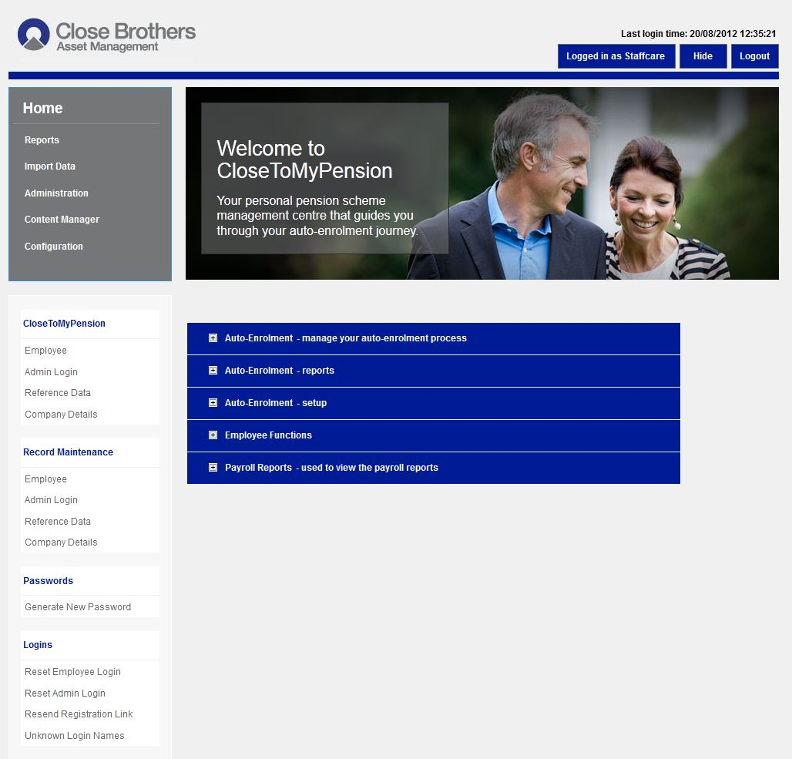

Slide 22
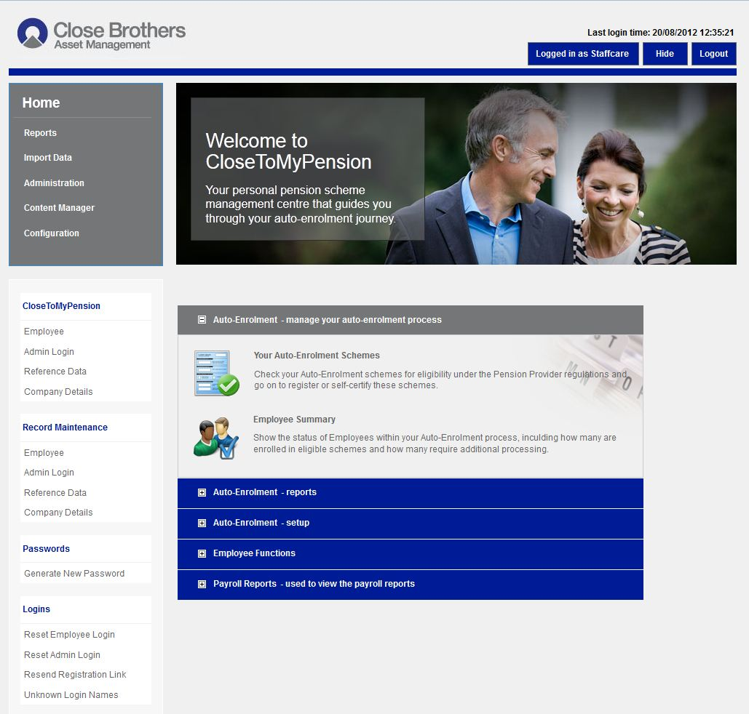

Slide 23
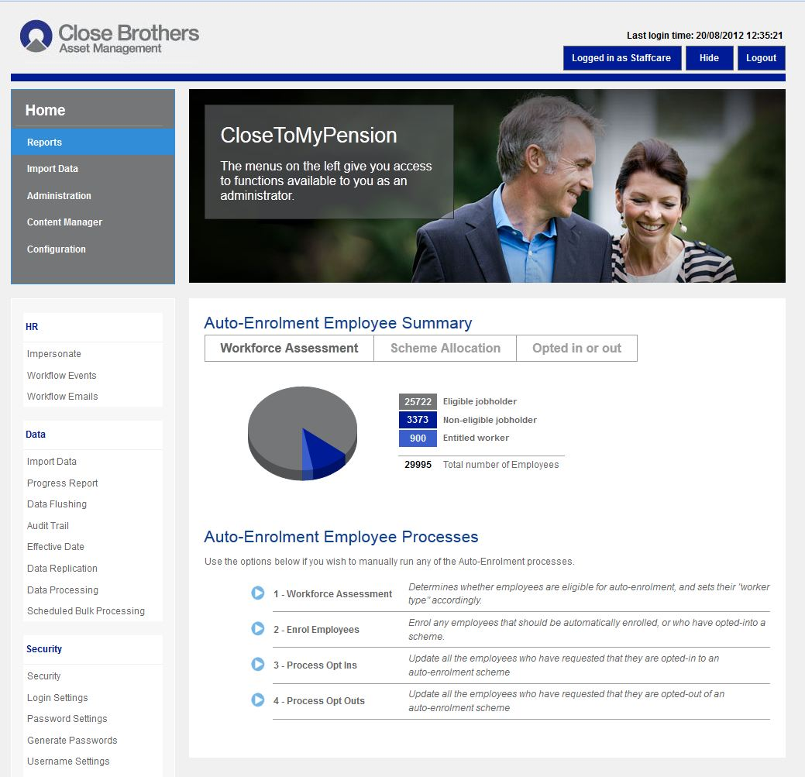

Slide 24
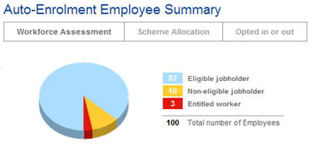
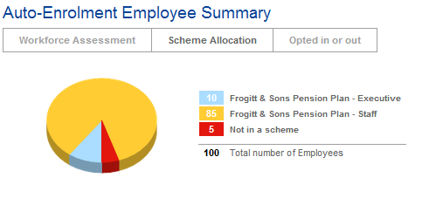
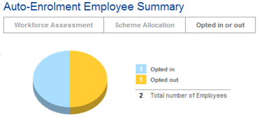

Slide 25
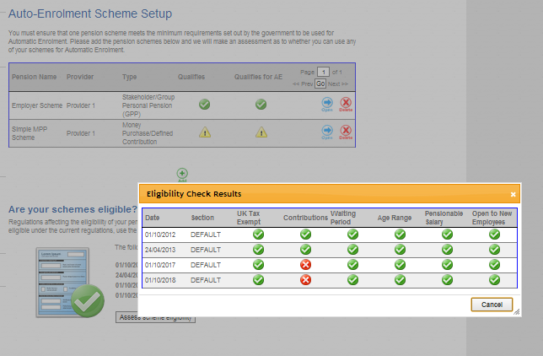

Slide 26
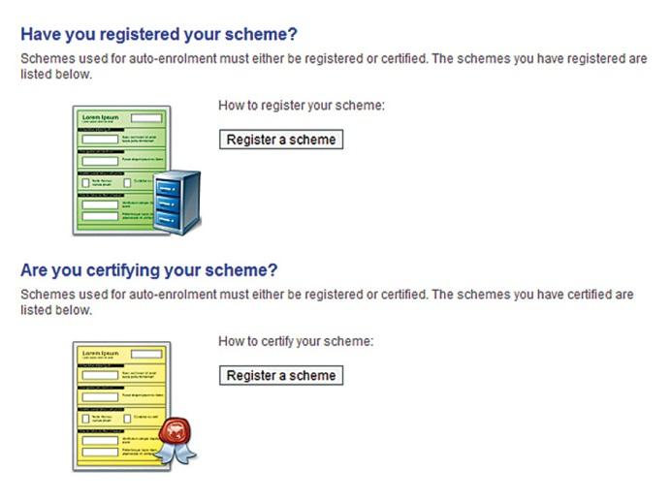

Slide 27
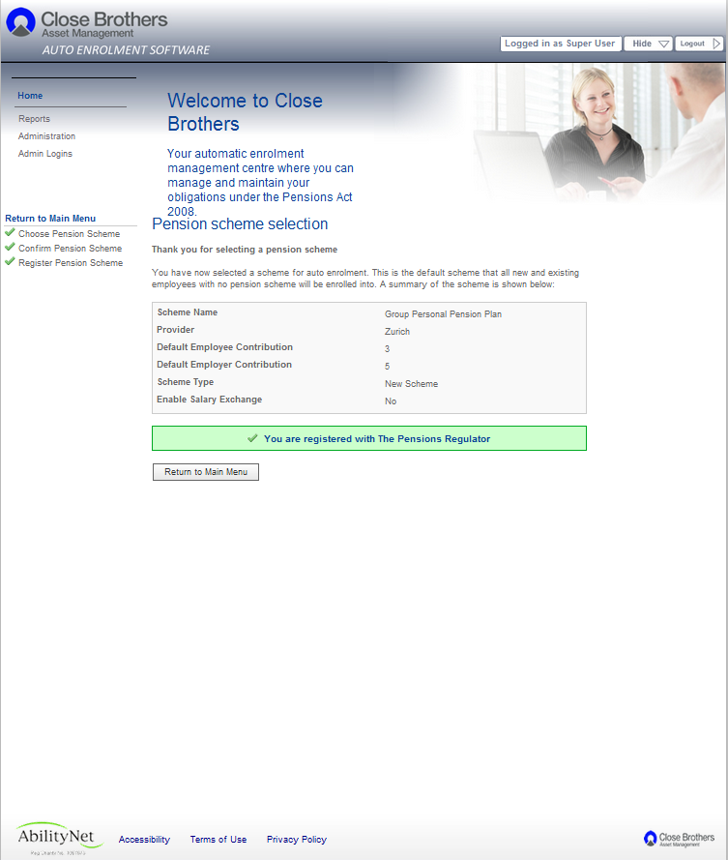

Slide 28
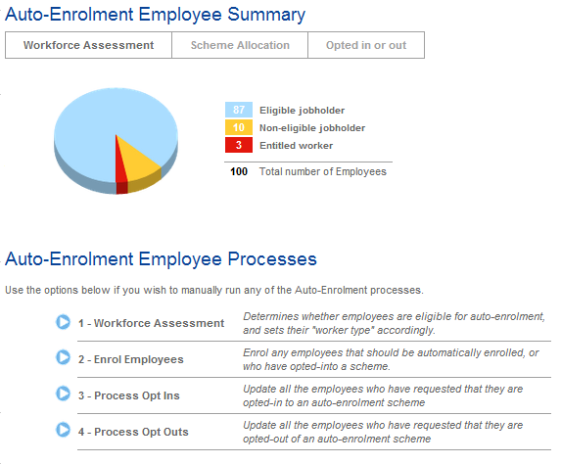

Slide 29
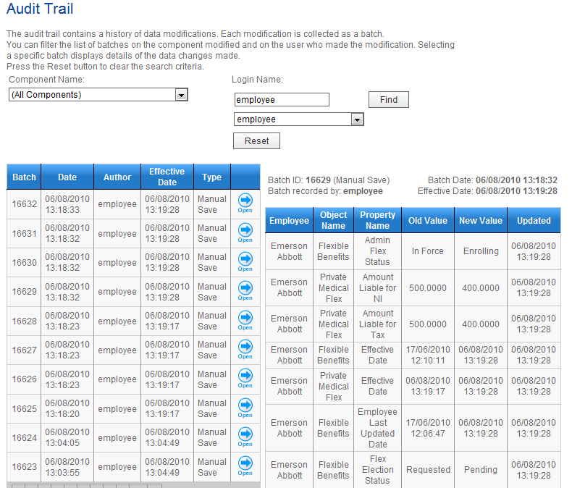

Slide 30
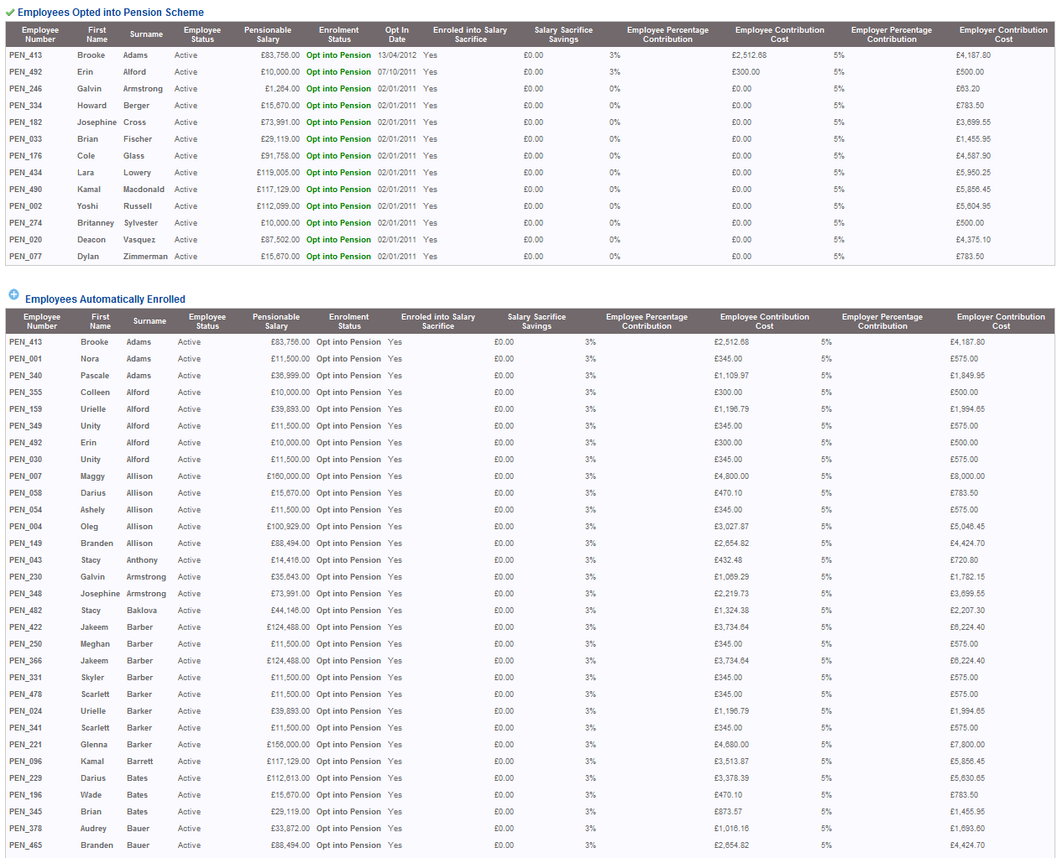

Slide 31
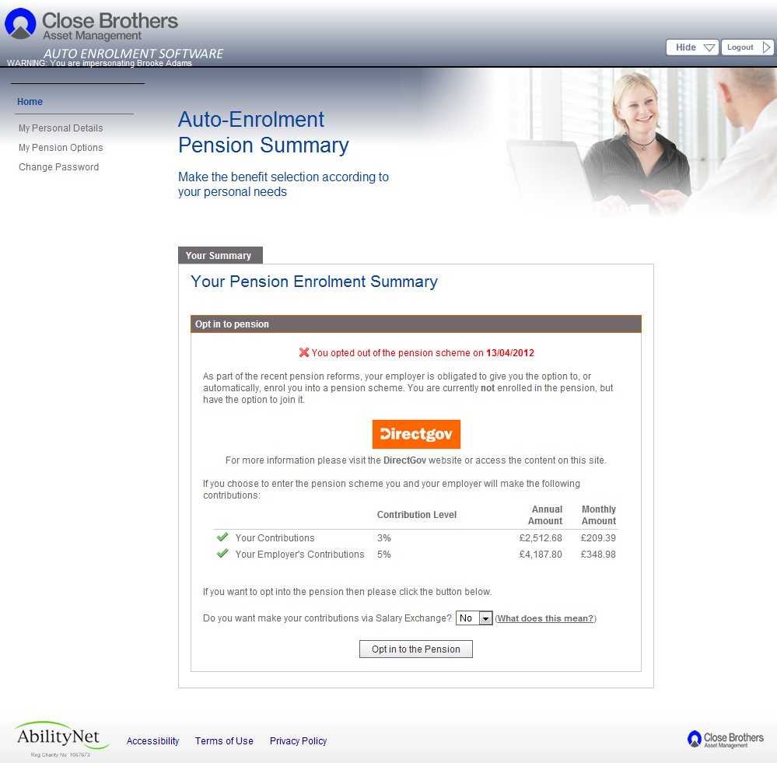

Slide 32
Communicate compliantly
The Pensions Regulator requires you to follow a prescribed format for communications
How will you communicate to all workers? (post, e-mail, SMS text)
How will you communicate effectively?
Effectively, each worker must have an AE audited record
Various communications required include:
postponement notice
assessment
auto enrolment
opt-out
opt-in
re-enrolment

Slide 33
Report as required
You will need to be able to report on:-
Full employee data
Contracts
Eligibility data
Membership data
Contribution payments and dates
Automatic enrolment dates
Details of your Qualifying Workplace Pension Scheme(s)
Opt in notices
Opt out notices
Opt out data
Individual records
Retain records for up to 6 years (4 years for opt-outs)
The ability to report retrospectively is vital
Your reporting needs to be able to show a robust audit trail

Slide 34
Re-assess each pay reference period
Prepare for the on-going operational drag of AE
Systemise all that you can
Leverage technology to the full
Over time, if your systems, processes and technology work well, the situation will normalise, as with many of your existing business functions
Accounts
Payroll
Employee Benefits
Health & Safety
Absence Management, and so on

Slide 35
Project manage inclusively
Involve HR, Payroll, Finance, Pensions & Benefits, Legal, Advisers, Trustees, Staff
Planning
24m-12m
Strategy
11m-7m
Design
6m-4m
Implementation
3m-1m
Staging date
Capture key data from employer, HR / payroll processes, pay reference periods and contracts of employment (legal input)
Assess data and establish costs, identify internal process requirements, data cleansing, agree employee communications, consider key roles and responsibilities
Detail project plan, includes review of existing pension arrangement(s) and structure and design of new arrangement(s), start employee communications, consider postponement period
Implementation of agreed strategy and design, work with auto enrolment software in parallel with existing processes, implement postponement and opt-out processes
Employee assessment communications if postponement, monitor opt- outs, refunds, opt-ins, register scheme with TPR, compliance record keeping, re-enrolment processes

Slide 36
Project risks
Knowledge
Change mgt.
Project mgt.
Audit
Financial
Regulatory
Four key areas
Capacity
Data
Commercial
Fraud
Timing
Legal
Supplier
Technology
Communications
Operational

Slide 37
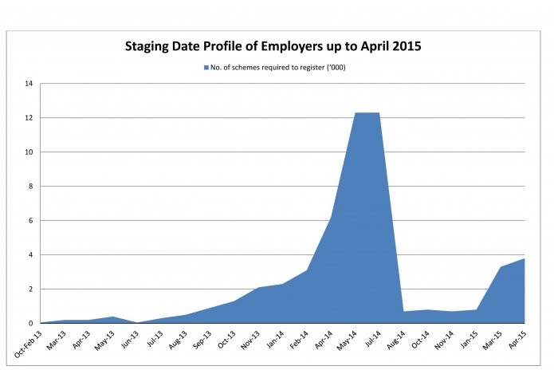
Market capacity issues

Slide 38
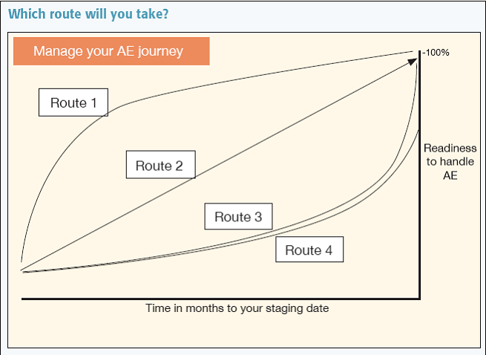
Don’t delay!

Slide 39
Postponement Rules
Employers may postpone auto enrolment for up to 3 months
Postponement offers many potential advantages
Postponement defers the assessment of the worker
Can operate different postponement periods for different employee groups
A notice of postponement must be issued to workers
Can be used from the staging date, first day of employment or date worker becomes eligible after staging date
Why might you want to use postponement?
Smooth the process of staging e.g. auto enrol different groups of workers
Align with payroll processes
Smooth process for workers with spikes in earnings
Facilitate contractual joining for salary exchange
Challenges:
There are so many complex factors to consider – should you? If so how?
There are 4 different types of postponement notice!

Slide 40
Non Inducement Rules
Irrespective of staging date, from July 2012 ensure your processes do not unintentionally fall foul of:-
Prohibited recruitment conduct
e.g. asking job applicants if they plan to opt out
Inducements to opt out
Detrimental treatment / unfair dismissal as a result of new employer duties
Actions / omissions which remove Qualifying Scheme status

Slide 41
Special considerations for AAT members
Let’s talk through:-
What will be the needs that you can anticipate your clients having?
What resources do you need to be able to assist and guide them?
What will be your approach to their technology requirements?
To what extent do you see AE as a commercial opportunity?
What scope is there for us to work collaboratively?
How would you like us to help you help your clients?

Slide 42
Summary and next steps
Auto-enrolment affects every organisation
It is much more complicated than people realise
Planning needs to start now!
We can provide the full range of support services

Slide 43
Any questions?

Slide 44
For a copy of these slides please: Tel: 0845 450 7897 or Email: ebs@closebrothers.com Thank you!
Issued by Close Asset Management Limited (Company No.1644127) which is registered in England and Wales, is authorised and regulated by the Financial Conduct Authority and is a subsidiary of Close Brothers Group plc. Close Asset Management Limited uses the trading name Close Brothers Asset Management. Registered office at 10 Crown Place, London EC2A 4FT
Close Brothers Asset Management is a trading name of Close Asset Management Limited and is part of Close Brothers Group plc. Close Asset Management Limited is registered in England and Wales and authorised and regulated by the Financial Services Authority. Registered number: 01644127. Registered office: 10 Crown Place, London EC2A 4FT. VAT registration number: 245 5013 86.
CBAM2020 Auto Enrolment AA version AAT April 2013

